Slide 1
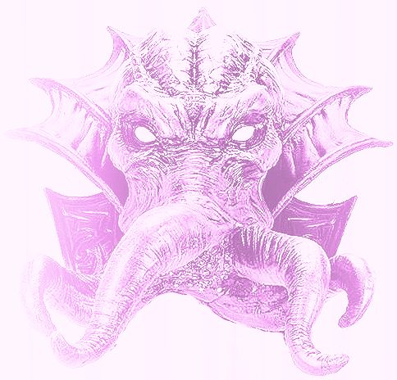
Mindflayer
A three component framework for utilizing a distributed system seamlessly and with little effort.

Slide 2
Why Should You Care?
Cloud computing
Enterprise scale systems
Peer to Peer communication
Improve on tools already in use

Slide 3
How Mindflayer Works Component 1: The Master Replica Set
Has global knowledge over the entire system (Omniscient)
Knows all topics, which services are producers/consumers
Facilitates the service discovery process
User API that tells it to run a containerized application
As close to 100% uptime as possible
Replica protocol to facilitate synchronization

Slide 4
How Mindflayer Works Component 2: The Minion Process
Facilitates the interface between the Master Replica Set and the physical machines
Receive commands from the Master Set
Executes locally on the physical machines

Slide 5
How Mindflayer Works Component 3: Language Specific API Libraries
Creates data producing functions to send topic data to consumers
Creates functions for consuming data of a topic sent by producers
Done through direct peer to peer networking.

Slide 6
Difficulties and Accomplishments
Difficulties
Accomplishments
One of us has no network programming skills
Our Master, Producers, and Consumers connect and transmit data.

Slide 7
Future Expansion
Containerization
Make Consumer Producer Libraries APIs
Master API
Topics
Minion/Henchman

